Slide 1


Formation
Wednesday January 18th
Development and deployment
Plugins
Didier Vojtisek (SED Rennes)
didier.vojtisek@inria.fr

Slide 2
This lesson is mainly a bunch of tip and tricks useful to get started building your own eclipse plugins and deploy it for distribution.
This isn't about using eclipse for building a classic java application

Slide 3
Content
Eclipse plugin structure and lifecycle
Platform architecture
OSGI base
Plugin specific
Dependency inversion
Services
Extension point
Building "basic" GUI
Useful wizards for UI prototyping
Deployment best practices
Easily create update site or ready to install bundle
Continuous integration

Slide 4
Eclipse plugin structure and lifecycle
integrated development environment with base workspace and an extensible plug-in system
Contribute to existing IDE
Open structure with thirdparty contributions
Update site, market place, …
Or create your own application
Rich Client Platform (RCP) for developing general purpose applications
-> component based / service base approach
Equinox : an implementation of OSGI core framework

Slide 5
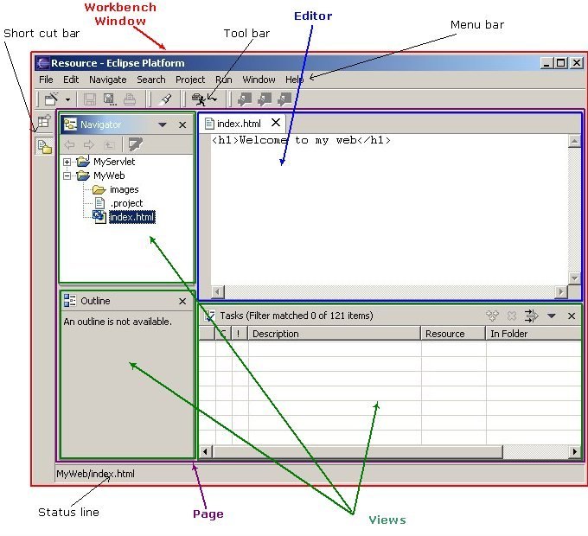
Some vocabulary

Slide 6
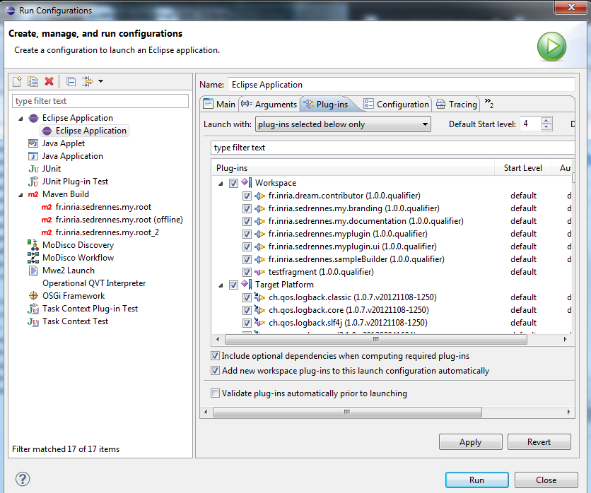
Runtime workbench (i)
Run Configurations (or debug) > Eclipse application
Possibility to finely tune which plugin is deployed

Slide 7
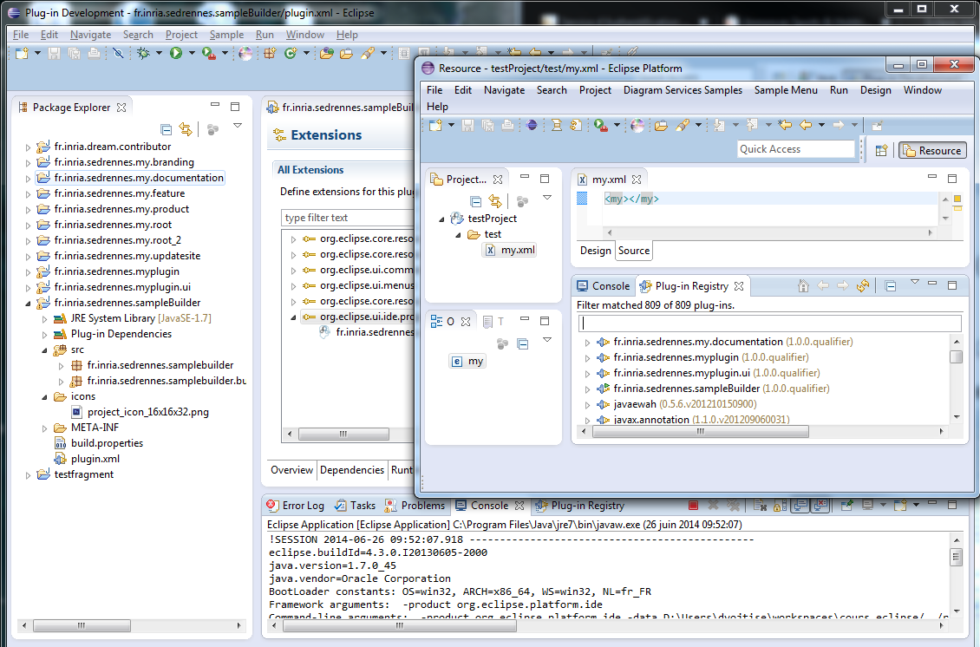
Runtime workbench (ii)
First eclipse with the source of your plugins
Second eclipse with your plugin deployed "as if they were installed"
Host console usually gets standard outputs

Slide 8
Some general good practice
Enforce encoding for all developpers
UTF8
Either at the project level or at the workbench level

Slide 9


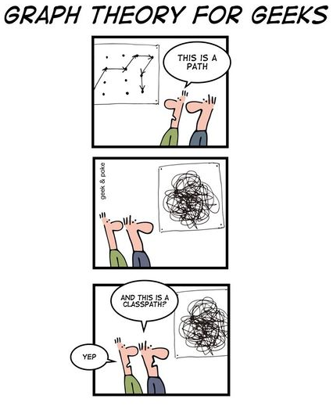
OSGI Bundle ≈ Eclipse Plugin
Mix of technologies
The platform may provide several may to achieve a goal.
But current practice in Eclipse development may vary
OSGI mostly used for component management
Dynamic loading
Dependency management (incl version range)
Classpath management
(Service)
Eclipse Plugin
UI definition and contribution
Distribution (Market place, update site)
Service
Notes:
Utilisation des icones pour distinguer les info plutôt OSGI ou plutôt Eclipse

Slide 10
OSGI
Lifecycle
Service / extensions point
Dependency injection

Slide 11

Domaines d’application
Systèmes embarqués
Véhicule de transport (automotive)
Passerelle résidentiel/domotique/immotique
Contrôle industriel
…
Cependant
Tout concepteur d’application est gagnant à distribuer son application comme un ensemble de bundles
Cela évite le casse tête du CLASSPATH, lib/ext du JRE ou J2SESDK, …
Exemples : ANT, JEdit, JMF… OCF/javax.comm
Eclipse Equinox 3.0 utilise OGSi pour le chargement/déchargement des plugins (http://www.eclipse.org/equinox/index.html)

Slide 12
Eléments techniques d'OSGi
Repose sur :
Java
La programmation orientée services
Trois couches : le bundle, le package, le service
N'est pas :
Un système distribué (Pas d'invocation distante)
Seul le chargement de bundle peut se faire à distance

Slide 13
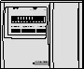
OSGi : structure d’un bundle
Contexte
Console
Fabriquant (Schneider)
1011
0110
1110
Services
fournis
Services
requis
.class
1011
0110
1110
Réseau de déploiement
Appareil d’analyse de puissance électrique
.class
Packages
exportés
1011
0110
1110
Packages
importés
Console
Compteur électrique
.class
manifest
Bundles
Réseau de terrain
Intégrateur
OSGi
Passerelle embarqué
SEPAM

Slide 14
OSGi : Une application type
Contexte
Administrateur
Démarrage d’un service
1
2
> start 5
> uninstall 3
5
5
4
3
3
Notification
Arrêt d’un service
Dépendance de packages
Dépendances de services

Slide 15
OSGi : Une application type
Contexte
Administrateur
> start 5
1
2
> uninstall 3
5
5
4
Notification
Dépendance de packages
Dépendances de services

Slide 16
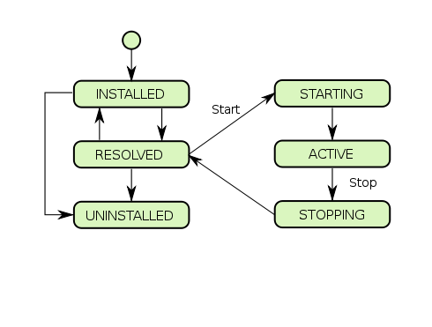
OSGI bundle/plugin lifecycle
Bundle State | Description
INSTALLED | The bundle has been successfully installed.
RESOLVED | All Java classes that the bundle needs are available. This state indicates that the bundle is either ready to be started or has stopped.
STARTING | The bundle is being started, the BundleActivator.start method will be called, and this method has not yet returned. When the bundle has an activation policy, the bundle will remain in the STARTING state until the bundle is activated according to its activation policy.
ACTIVE | The bundle has been successfully activated and is running; its Bundle Activator start method has been called and returned.
STOPPING | The bundle is being stopped. The BundleActivator.stop method has been called but the stop method has not yet returned.
UNINSTALLED | The bundle has been uninstalled. It cannot move into another state.

Slide 17
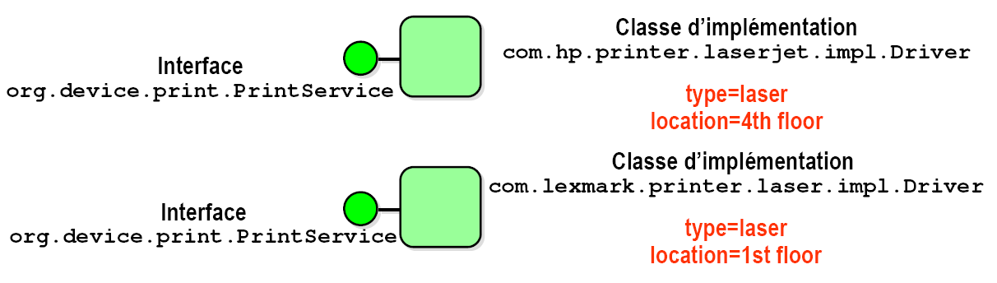
Services
Une interface «published» et des implémentations
se trouvent dans des packages différents
implémentation normalement non publique.
multiples implémentations possibles
« emballées » dans les bundles.
Qualifié par des propriétés.

Slide 18
4. Exemple de service
Interface org.device.print.PrintService
package org.device.print;
import java.io.OutputStream;
import javax.print.PrintException;
public interface PrintService {
public int print(OutputStream out, String[] printparams) throws PrintException;
public void kill(int jobnumber) throws PrintException;
public Job[] list() throws PrintException;
public Job status(int jobnumber) throws PrintException;
}

Slide 19

4. Exemple d’application

Slide 20
Manifest

Slide 21
Manifest (i) Déclarations interfaces
Import-Package | Packages requis (avec/sans la spécification de version)
Export-Package | Packages fournis (avec/sans la spécification de version)
Import-Service | Services requis
Export-Service | Services fournis
Bundle-Activator | Nom de la classe Activator
Bundle-ClassPath | Emplacement des classes et ressources du bundle
Require-Bundle | Dépendance vers un bundle plutôt que via une liste de package

Slide 22

Manifest (ii) Propriétés courantes
Bundle-Name | Nom du bundle (pour l'utilisateur)
Bundle-Version | Version du bundle
Bundle-Activator | Nom de la classe Activator
Bundle-ClassPath | Emplacement des classes et ressources du bundle
Bundle-RequiredExecution Environment | Liste d’environnement qui doivent être présents sur la plateforme ( exemple : CDC-1.0/Foundation-1.0, OSGi/Minimum-1.0, JavaSE-1.7 )
Bundle-SymbolicName | Identifiant du bundle
Bundle-Vendor | Nom du fournisseur du bundle
Bundle-ActivationPolicy | Mode de démarrage (ex: lazy)
Eclipse- PlatformFilter | Filtrage. osgi.nl pour language, osgi.os pour l'OS, osgi.arch pour l'architecture, osgi.ws pour le sytème de fenetrage, Ex: (&(osgi.ws=win32)(osgi.os=win32)(osgi.arch=x86))

Slide 23
Manifest (iii) autres propriétés (plutôt OSGI)
DynamicImport-Package | Liste de package qui pourront être importés en cours d’exécution (com.acme.plugin.*)
Bundle-DocURL | URL de la documentation du bundle
Bundle-ContactAddress | Coordonnées du propriétaire du bundle
Bundle-Copyright | Copyright du bundle
Bundle-Category | Catégorie du bundle
Bundle-Description | Description du bundle
Bundle-NativeCode | Bibliothéques natives à charger en fonction du processeur, du SE, …
Bundle-UpdateLocation | URL des mises à jour du bundle

Slide 24
Exemple de manifest (i)

Slide 25
Exemple de manifest (ii)

Slide 26
Exemple de manifest (iii)

Slide 27
Activator et BundleContext

Slide 28
La classe Activator du bundle
Classe publique
Implémente les 2 méthodes start() et stop() de BundleActivator
qui reçoivent une référence sur un contexte.
start(BundleContext ctxt)
recherche et obtient des services requis auprès du contexte et/ou positionne des listeners sur des événements
enregistre les services fournis auprès du contexte
stop(BundleContext ctxt)
désenregistre les services fournis
relâche les services requis
Cependant le FW fait ces opérations si stop() en oublie !
il peut ne pas y avoir d’Activator dans un bundle

Slide 29
BundleContext
Interface vers le framework
Passé lors des invocations de start() et stop() de l’Activator
Permet
L’enregistrement de services
Le courtage de services
L’obtention et la libération des services
La souscription aux évènements du Framework.
L’accès aux ressources du bundle
L’accès aux propriétés du framework
L’installation de nouveaux bundles
L’accès à la liste des bundles

Slide 30
Enregistrement de services (Lexmark Laser Printer)

Slide 31
6. Recherche de services (TextEditor)

Slide 32
Recherche (Courtage) de services
Filtrage par des expressions de condition LDAP (RFC1960) sur les propriétés enregistrées par les services
Expressions de filtrage
Expressions simples (attribut opérateur valeur)
Valeurs de type String, Numerique, Character, Boolean, Vector, Array
Attribut insensible aux majuscules/minuscules
L’attribut objectClass représente le nom du service
Opérateurs >=, <=, =, ~= (approximativement égal), =* (présent)
Connecteurs logiques &, |, !

Slide 33
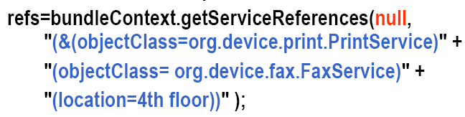
Recherche (Courtage) de services
Tous les services d’impression
Certains services d’impression
Tous les services de org.device
Le service d’impression et de fax au 3ième étage

Slide 34
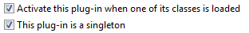
Consideration on the manifest
Lazy loading
Recommanded : allow on-demand loading of the bundles (based on 1rt access to a class of the bundle)
Singleton
Only one version of the bundle will be allowed
Mandatory for UI contributions
but discouraged for libraries
Where several versions may coexists
To force a plugin to start on Eclipse startup : use org.eclipse.ui.startup extension point

Slide 35
Version management
Required-Bundle (vs Import-Package)
Tightly link a bundle with another
Will not allow implementation substitution required by service implementations
But simplifies some deployment in environment where the naming of package isn't correctly respected
Do not mix Require-Bundle and Import-Package when referencing a component.
Depending on the classpath load order you may end up with different versions of the same class
"Cannot cast Foo with Foo" syndrom …
Inclusive, exclusive
S'assurer de mettre un upper bound pour éviter les soucis d'installation (ou aucune contrainte de version)

Slide 36
Eclipse plugin extension point
Services "à la Eclipse"
Usually preferred to OSGI service definition for UI contributions
Intensively used by the workbench UI
Defined in the plugin.xml file
A little bit less precise than OSGI services
Doen't allow many to many connection scenarios

Slide 37
Using Eclipse extension point
can be added through the plug-in editor’s Extensions tab, or to your plugin.xml
Plug-ins and extension points are expected to have the same unique identifiers following the Java package naming pattern.
Each extension point has a XML schema which specifies the elements and attributes that make up the extension
<extension point=”org.eclipse.ui.preferencePages”>
<page
class=”fr.inria.sedrennes.myplugin.preferences.
SamplePreferencePage”
id=” fr.inria.sedrennes.myplugin.preferences.
SamplePreferencePage”
name=”Sample Preferences”>
</page>
</extension>

Slide 38
Example extension points
to make some of these available
for your plug-in, you will usually need to add dependencies
Example | Meaning
org.eclipse.core.runtime .preferences | Allows plug-ins to use the Eclipse preferences mechanism, including the setting of default preference values.
org.eclipse.core.runtime .applications | A plug-in that wishes to use the platform but control all aspects of its execution is an application.
org.eclipse.core.resources .builders | Useful for IDE builders who wish to provide an incremental project builder, processing a set of resource changes.
org.eclipse.core.resources .markers | Markers are used to tag resources with use information – this marker can then be utilized in the problems view.
org.eclipse.ui.activities | The activity extension point allows the filtering of plug-in contributions from users until they wish to use them.
org.eclipse.ui.editors | Allows the addition of new editors to the workbench, which can be tied to particular file extension types.
org.eclipse.ui.intro | When Eclipse is first started up the welcome page, or intro is displayed. This extension point allows contributions to the welcome page
org.eclipse.ui.menus | Allows custom menus to be added to the workbench either in the main menu, toolbar or popup menus through the locationURI attribute.
org.eclipse.ui.perspective | Allows the addition of a perspective factory to the workbench, defining a particular layout of windows.
org.eclipse.ui.propertyPages | Adds a property page for objects of a given type.
org.eclipse.ui.views | Provides the ability to add views to the workbench.

Slide 39
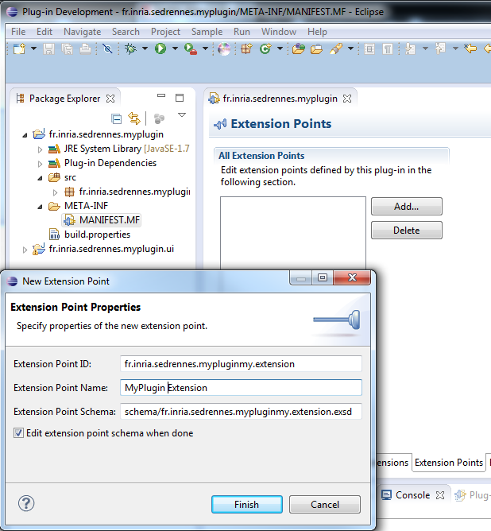
Defining you own extension point
Add extension point in the plugin.xml
Define the schema

Slide 40
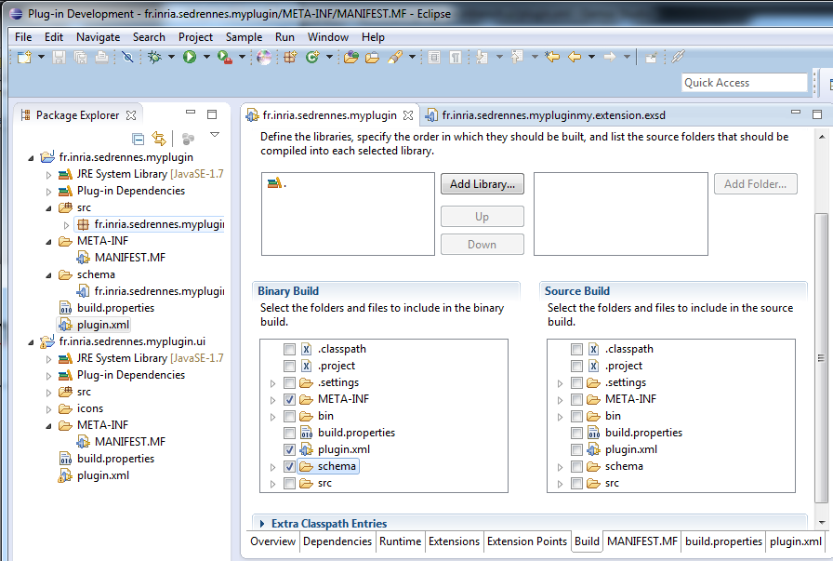
Extension point common errors
Do not forget the deployment of the schema definition in build.properties

Slide 41
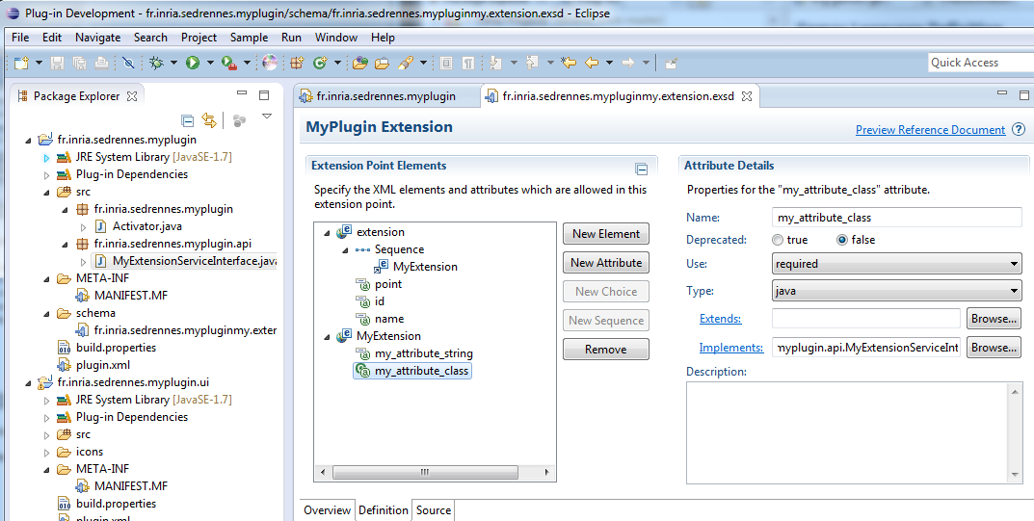
Extention point schema definition
Create elements and attributes for the extension
Use sequence to control multiplicities

Slide 42
Schema attributes
Attribute | Use
Name | The name of the extension point attribute.
Deprecated | Whether the attribute is deprecated or not.
Use | Whether the attribute is optional, required or default. Default allows you to specify a value for the attribute if it hasn’t been used.
Type | The available types are Boolean, String, Java, Resource and Identifier. While Boolean and String are self –explanatory, Resource should be used if the attribute is a file. Identifier provides a reference id for the extension point.
Extends | If the type is Java this must be the name of the class that the attribute must extend.
Implements | If the type is Java this must be the name of the class that the attribute must implement.
Translatable | If the type is String this Boolean value indicates whether the attribute should be translated.
Restrictions | If the type is String this can be used to limit the choice of value to a list of strings.
Description | Attribute documentation.
References | If the type is Identifier, this provides the id of the extension point that you want to reference. This will allow implementers of the extension point to easily find the id, without having to look through the plug-in registry.

Slide 43
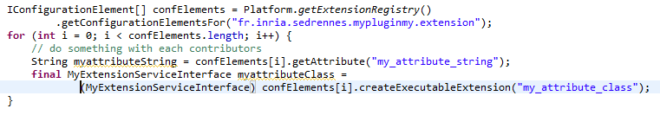
Code behind an extension point
get a list of all the implementers of your extension point
extension point id
Creates and returns a new instance of the executable extension .
Uses the classpath of the contributing plugin
Minimal code : do not forget to protect against bad use of your extension…

Slide 44
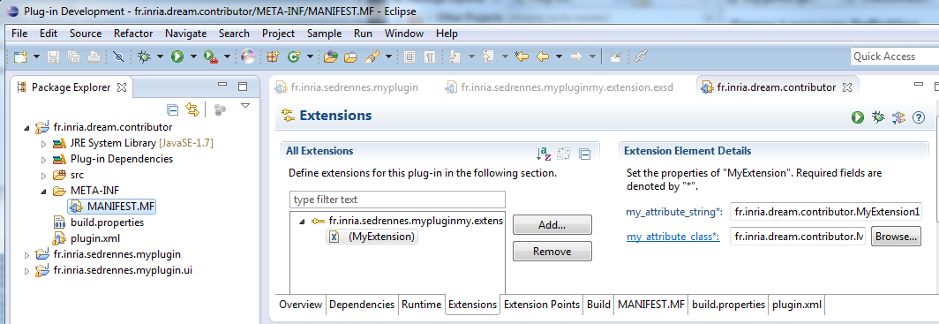
Using your new extension
Add the dependency
Add the extension
Fill the required attributes (and implement the classes by the extension)

Slide 45
Debugging a plugin
PDE support
Runtime workbench in debug mode
Consoles (in both eclipses)
Error view (if you have correctly use the logger)
Plugin registry view
OSGI host console
Some useful commands : ss, ss someword, start xxx

Slide 46
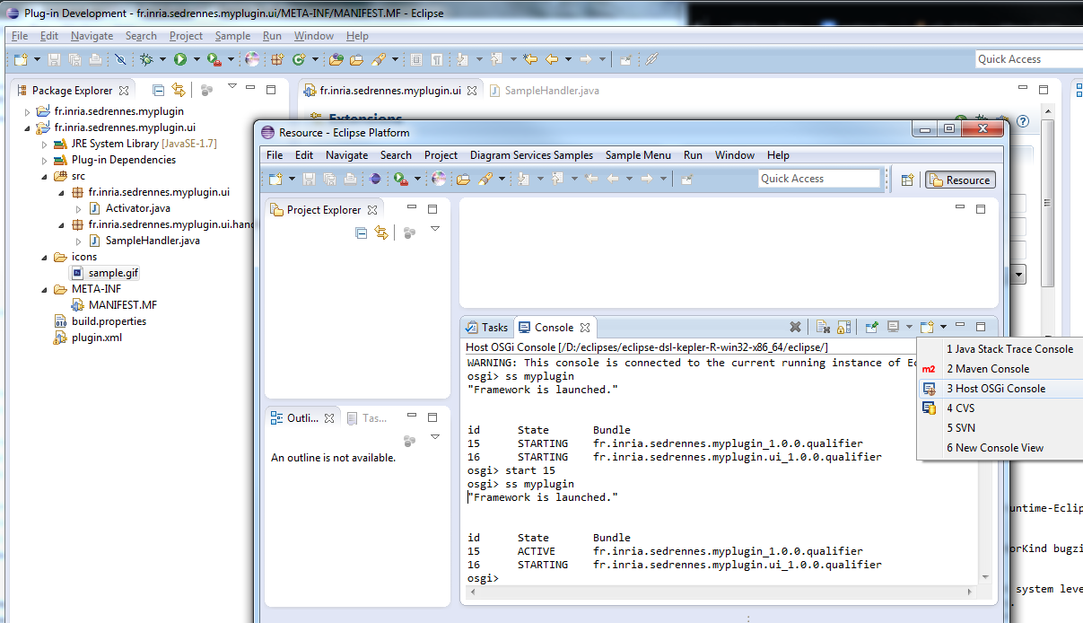
Debugging plugins / OSGI Console

Slide 47
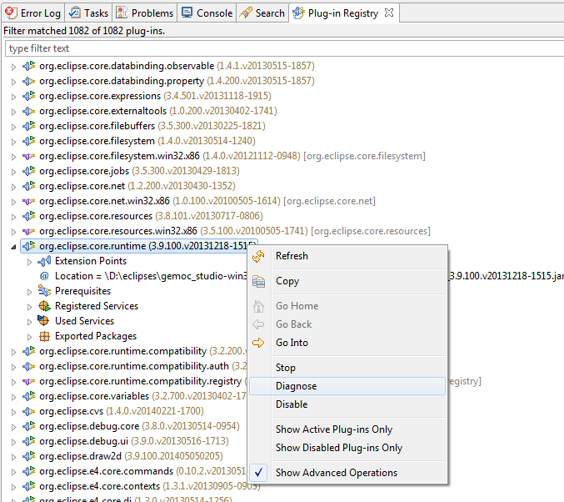
Debugging plugin / Plugin registry view
Check "Show advanced operation" to enable the diagnose and start buttons
Displays most information of the plugin contract
(including extensions and OSGI services)

Slide 48
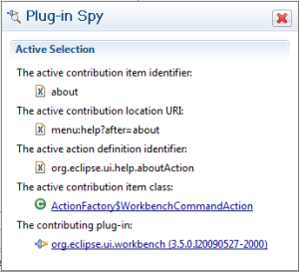
UI spy
UI part spy : Alt+Shift+F1
get information about the currently selected user interface component
Menu spy : Alt+Shift+F2
Find contributing plugin for a menu
Alt+Shift+F2, then click on the menu item that you want to inspect

Slide 49
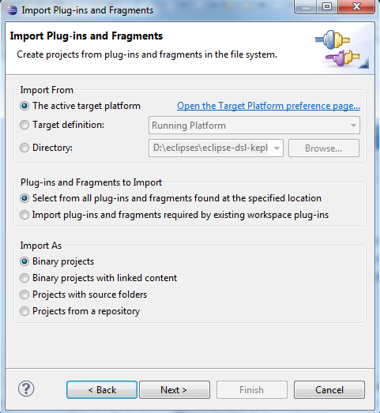
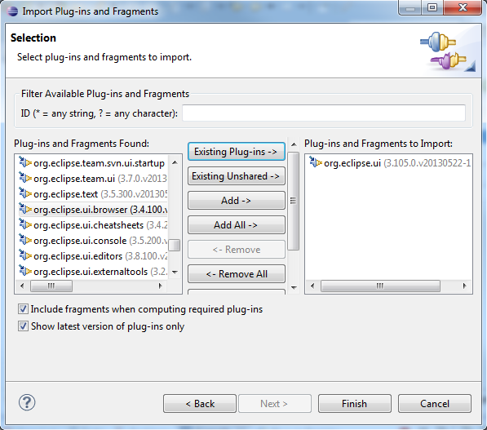
Project import
import the source of installed plugin
Allows to navigate in the plugin.xml and copy someone else definition
If available also show the java source …

Slide 50
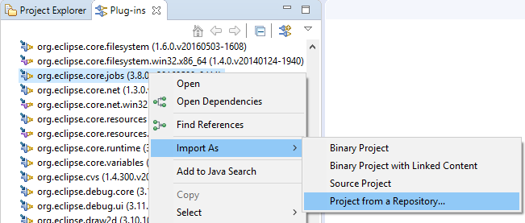
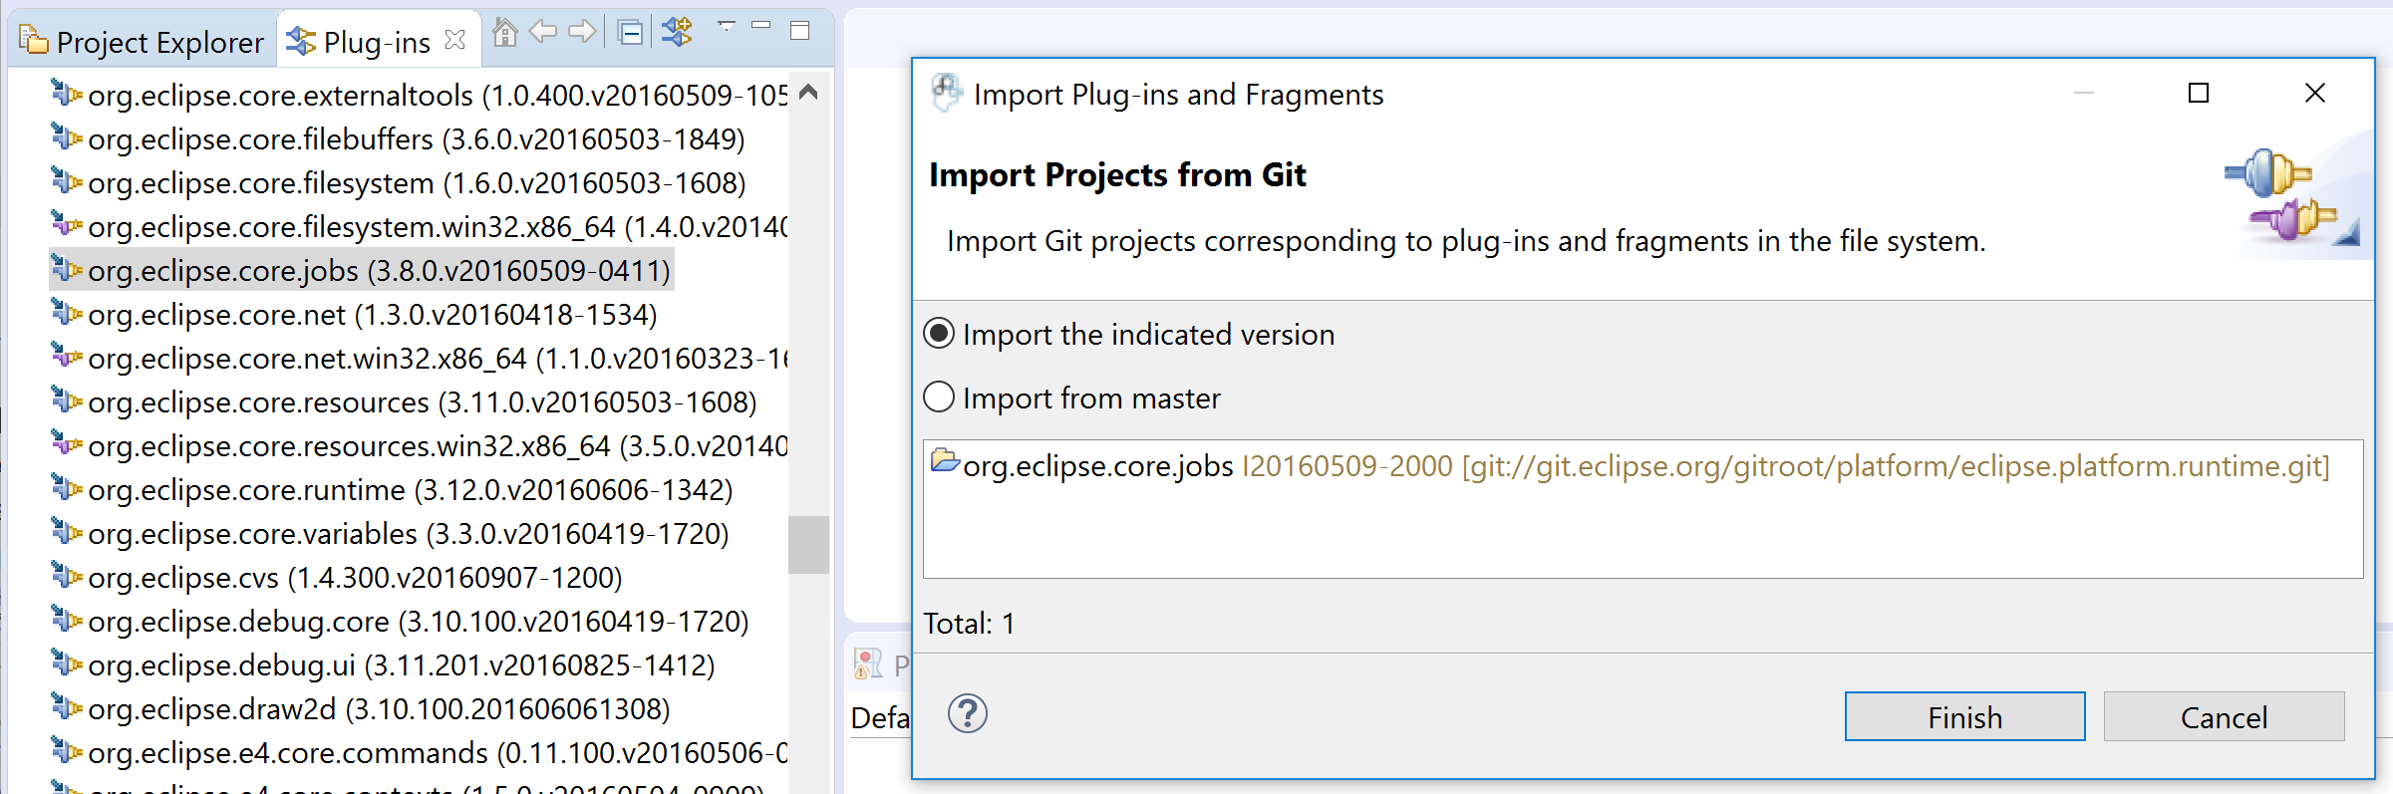
Import as > Project from a Repository
Enabled if the plugin manifest contains an Eclipse-SourceReferences entry

Slide 51
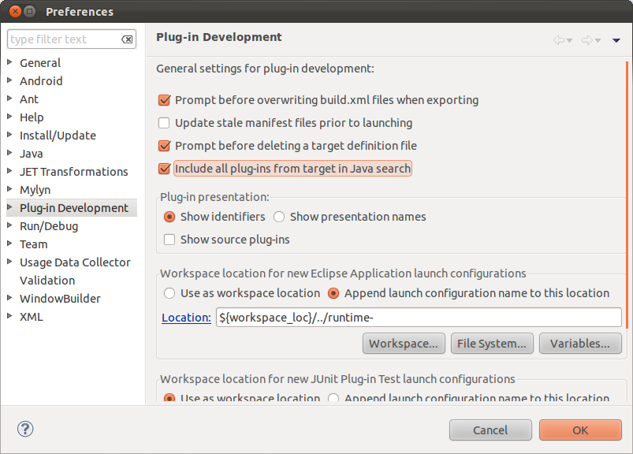
Include all plugins for java search

Slide 52
More search methods
http://www.vogella.com/tutorials/EclipseCodeAccess/article.html

Slide 53
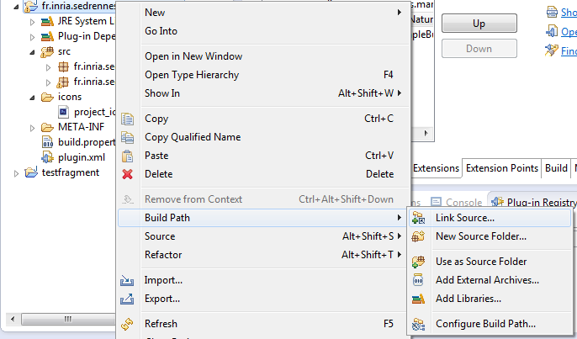
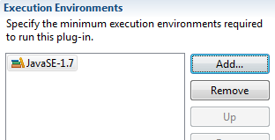
Common errors
Java configuration vs plugin configuration
Eclipse supports pure java project, adding a jar directly in java classpath will not make it available when deployed
Java version in manifest
When creating a plugin, it automatically adds a minimum java version
If you develop with recent java, but want to distribute for older versions…

Slide 54
Common errors / Deployment issues
Plugin in runtime workbench are not deployed in a jar, looking for resource may depend on the deployment
Eclipse URI
Platform:/plugin/fr.inria.sedrennes.myplugin
Platform:/resource/fr.inria.sedrennes.myplugin

Slide 55
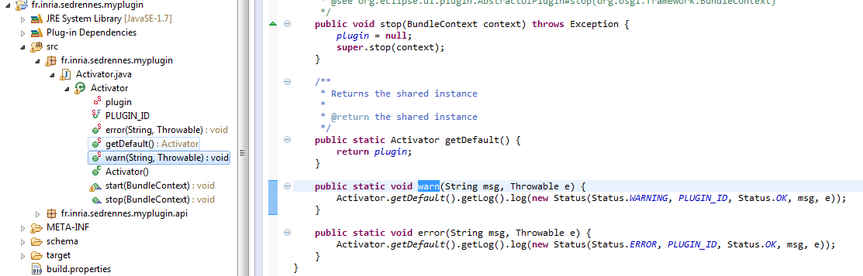
Best practices
Add an helper logger in your plugin Activator for internal errors
try{
}
catch (Exception e) { Activator.error("my error", e);
}

Slide 56
Best practice
Avoid renamming plugins
Otherwise you'll need to retrieve all references
Choose a name including your institute/team
Use your plugin name as package prefix for all your code
Follow java naming conventions
Create separate plugins for domain code and user interface code.
Make sure to limit dependencies
(especially for non UI plugin which are reusable)

Slide 57
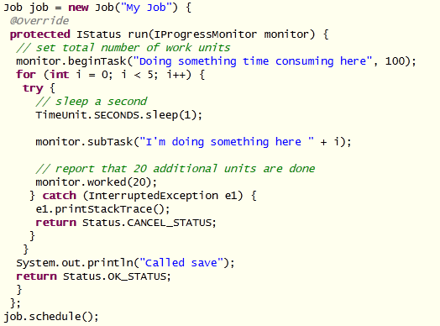
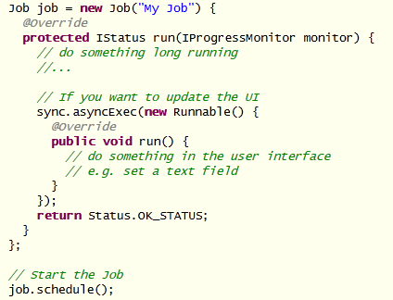
Eclipse jobs
Be careful to heavy computation in the main UI thread
https://www.eclipse.org/articles/Article-Concurrency/jobs-api.html
http://www.eclipse.org/articles/Article-Progress-Monitors/article.html
Reporting progress
Starting an Eclipse Job
Possibility to add scheduling rules for preventing task from occuring at the wrong time.
Ex: job.setRule(ResourcesPlugin.getWorkspace().getRoot());

Slide 58
Progress monitor
Use of SubMonitor
Split() deals with job cancellation check by throwing a OperationCanceledException
void doSomething(IProgressMonitor monitor, Collection someCollection) {
SubMonitor subMonitor = SubMonitor.convert(monitor, 100);
// Create a new progress monitor for the loop.
SubMonitor loopMonitor = subMonitor.split(70).setWorkRemaining(someCollection.size());
for (Object next: someCollection) {
// Create a progress monitor for each loop iteration.
SubMonitor iterationMonitor = loopMonitor.split(1);
doWorkOnElement(next, iterationMonitor);
}
// The original progress monitor can be used for further work after the loop terminates.
doSomeWork(subMonitor.split(30));
}

Slide 59
Basic Eclipse UI
Builder
Popup
Help
Editor
View
Eclipse UI components must be in plugin singleton

Slide 60
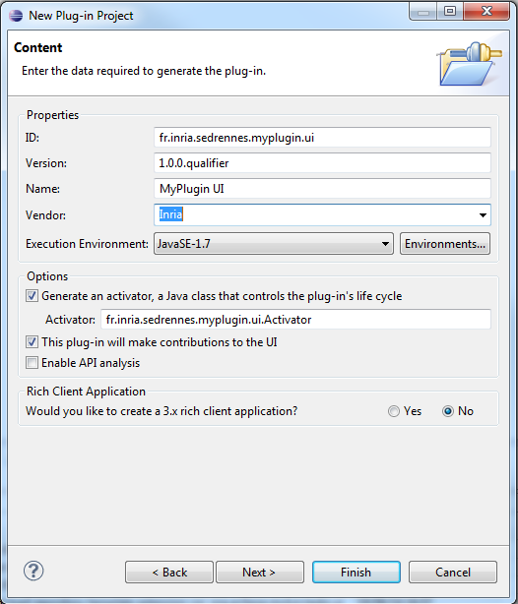
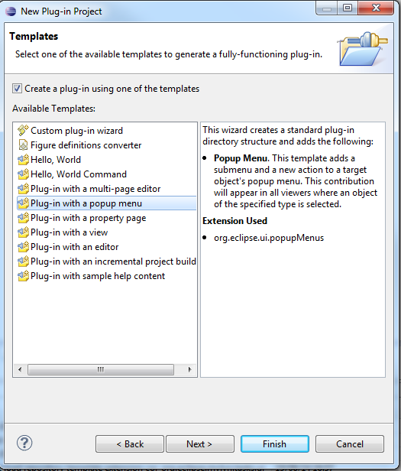
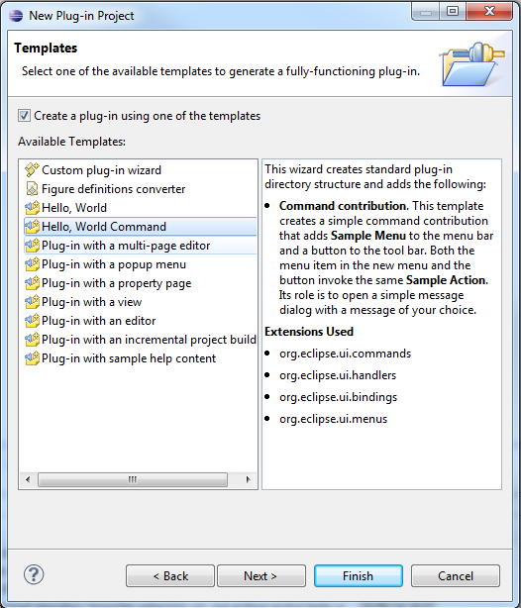
Basic popup

Slide 61
Basic Popup action
Wizard
Cool and easy to use but deprecated ☹
Basic use :
Ifile selectedIFile = null;
…
public void selectionChanged(IAction action, ISelection selection) {
if (selection != null & selection instanceof IStructuredSelection) {
StructuredSelection ss = (StructuredSelection) selection;
Object o = ss.getFirstElement();
if (o instanceof IFile) {
selectedIFile = (IFile) o;
}
if (o instanceof IAdaptable) {
IFile res = (IFile) ((IAdaptable) o)
.getAdapter(IFile.class);
if (res != null) {
selectedIFile = res;
}
}
}
}

Slide 62
Popup action (not deprecated) = Menu, Command
Define a command
Create an handler for the command
Create a menu that calls the command

Slide 63
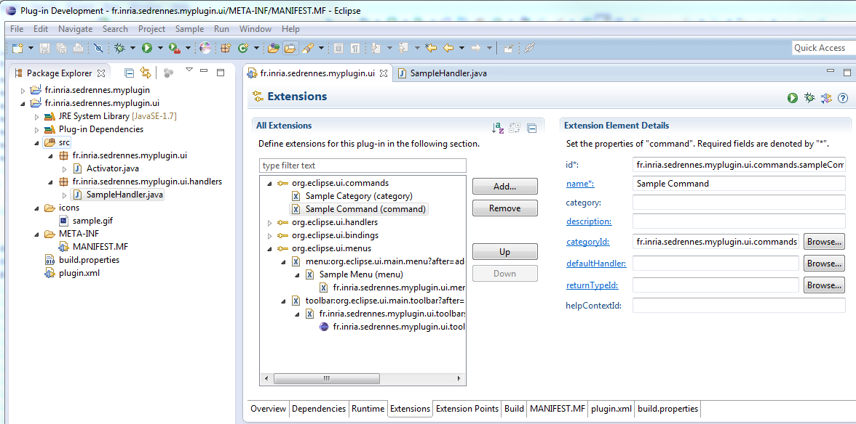
Popup, Menu, Command

Slide 64
Popup, Menu, Command
Attribute Name | Required
menu:org.eclipse.ui.main.menu?after=window | Insert this contribution on the main menu bar after the Window menu
menu:file?after=additions | Inserts contribution in the File menu after the additions group
toolbar:org.eclipse.ui.main.toolbar?after=additions | Insert this contribution on the main toolbar
popup:org.eclipse.ui.popup.any?after=additions | Adds this contribution to any popup menu in the Application

Slide 65
Filtering on extension
http://wiki.eclipse.org/Menu_Contributions/IFile_objectContribution
Tip : find available id
Ex:contentTypeId
Use Plugin registry view and search for "contentTypeId*something"

Slide 66
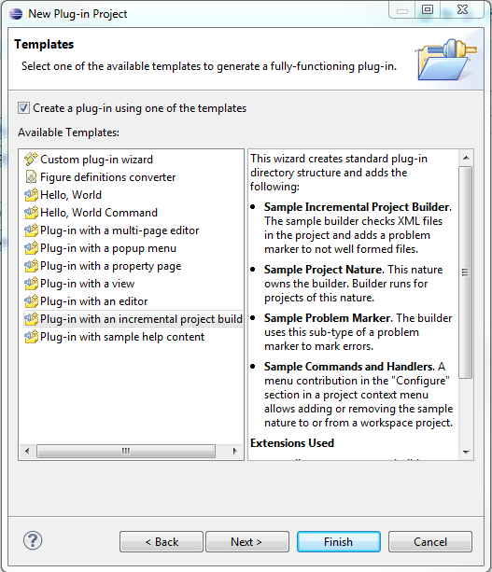
Builder
Allow to launch a job by listining changes in the workspace.
Easily create incremental builder
Usually associated to a project nature to help filtering
Works in a resource visitor
Support for problem marking (ie. Add red cross on file and underline the error in the text)

Slide 67
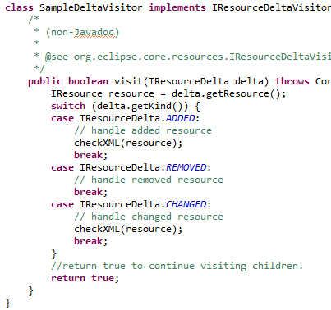
Builder (ii)
The DeltaVisitor is called when some event occurs in the project with the correct nature
Simply indicates which actiont to do depending on the event or the concrete nature of the resource
Must launch a job if the task is long

Slide 68
NatureProjectImage
Add an overlay image for project with your nature
Simply use the org.eclipse.ui.ide.projectNatureImages extension

Slide 69
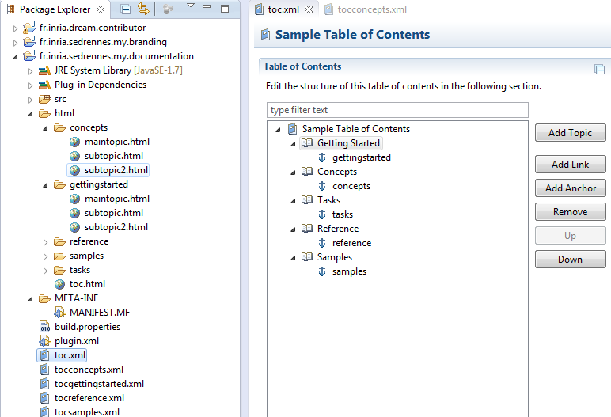
Eclipse Help
Help embedded in Eclipse itself
This is simply a set of html files referrenced in a table of content (toc.xml) file
Can point to external pages
Anchor allows to create documentation that is spread in several plugins. Each concributing to an anchor
Can use link that triggers actions in the workspace

Slide 70
Exemple plugin : example deployer
Goal, package a sample project so end user can import it to test your tool.
Principle
Contribute to newWizard extension that unzip the sample project files

Slide 71
UI Plugin commons errors
Do not forget to add resources to the build (icons,…)
Partial renaming
There are some ids scaterred in the code and the xml files ☹

Slide 72
Building plugin / managing internal libs
Avoid to use "extra classpath dependecies" (used only for compilation)
Prefer "add Library"
Do not forget adding the jar in the build tab

Slide 73
Deploying/distributing Eclipse plugins
Eclipse offers several ways to package your plugins and distribute them
Concepts dedicated to distribution
Bundle/Plugin
Fragment
Feature
Update site
Product

Slide 74
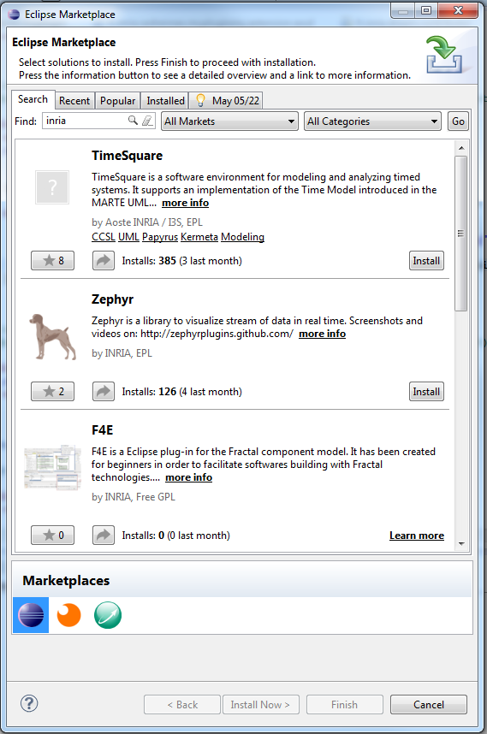
Deployment techniques
Manual copy of plugins jar into dropins folder
On start of eclipse, it will try to resolve them
Recommanded only for test purpose or early prototypes
Update site
Can be archived in a zip
Controls plugin compatibility
Installs required dependencies (if
Usually distributed through a simple web server
Can be referenced by a market place
Usually accessible from eclipse Help > Eclipse marketplace
Ex: http://marketplace.eclipse.org/
RCP / Eclipse package / Application
Eclipse with your plugins preinstalled
Full control of which other plugins are installed
From full eclipse GUI to headless
Control of branding
Splashscreen, window icon, about box, application name …
Best solution for reproductible demos

Slide 75
Feature
Main deployment unit used by eclipse
Main support for licence and descriptions for end users
Can declare
included plugins (and fragments)
nested features
Dependent plugins or feature
Ensures that on installation (provisionning) in an eclipse everything is installed with the correct versions
A branding plugin that will contain branding content

Slide 76
Fragment / Binary management
If a plugin can contain several binaries for different OS, it cannot contain different variant of the same java class to handle them
A fragment contributes content to a host plugin
Usually use filter for OS, windowing system, …
Use of fragment

Slide 77
Update site
Also called P2 repository
Deploys features
Organized in categories
Technically it's
a folder with features, plugins subfolders
Some metadata for discovery (zipped in a jar)
content.xml (dependencies)
artifacts.xml (identification and size of the deployed artifact)

Slide 78
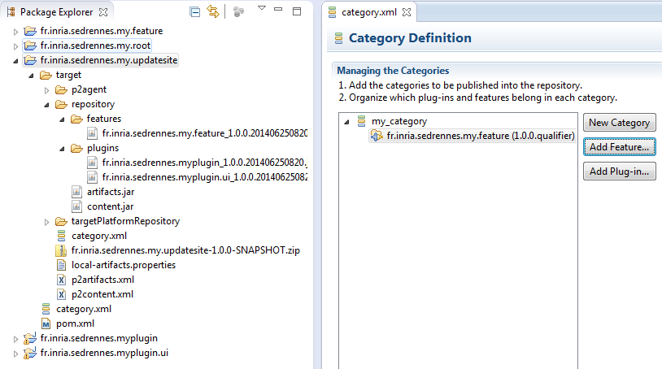
Update site
Category.xml
Avoid site.xml which have less support from tycho

Slide 79
Product
Application vs Product
Application is the launcher
a product may contain several applications
An application may be used without UI (Headless)
Main product kind
RCP : "light" version, may not look as an Eclipse IDE
Standard IDE, your plugins contributes new features
SDK IDE, also contains development tools (PDE, Java, …)

Slide 80
Build techniques
Manually via the GUI
Ant script + command line
Calls the internal pde application
Maven-bundle-plugin
Uses maven dependency system : allows fine control of dependencies
Good for pure OSGI components
But require good knowledge of OSGI and maven
Also require to deploy eclipse plugins in a maven repository
Maven-tycho
Uses eclipse system : good tooling support
Slow

Slide 81
Maven reminder
Build system
Automatic download of tools and dependencies
Dependency management (not used in our case)
Repository management (not used in our case)
Convention over configuration
Output is generated in "target" folder
-> gitignore / svnignore

Slide 82
Continuous integration (jenkins)
Jenkins available on http://ci.inria.fr
Current easiest solution
Develop as usual in eclipse
add Maven + tycho

Slide 83
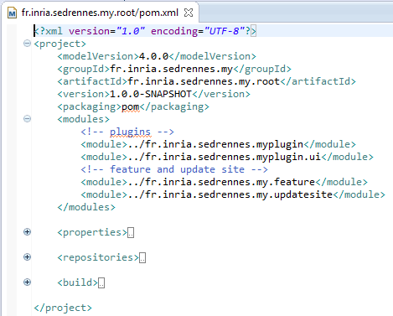
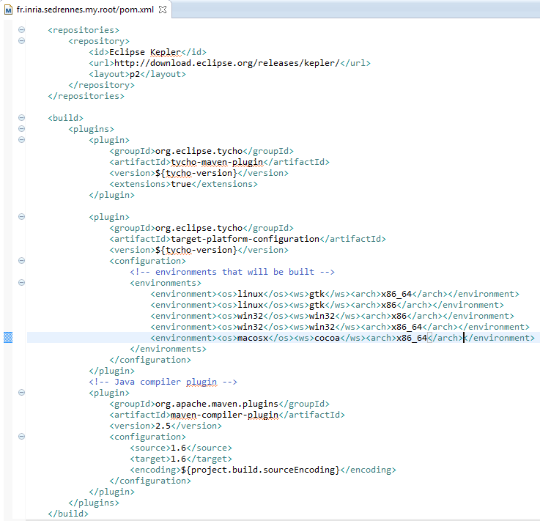
Maven + tycho
Each plugin, feature, need a simple pom.xml
One root/parent maven project
Module
Central point for building a set of related plugins/feature
Reusable parent
centralizes common maven properties and tool configuration
Including definition of repositories containing external dependencies plugin

Slide 84
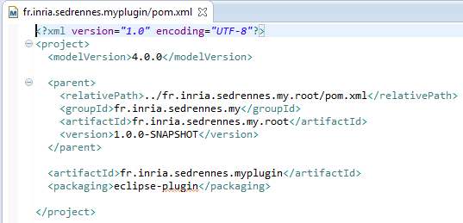
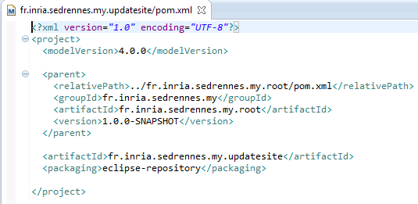
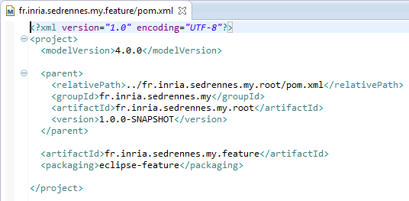
Pom.xml for plugin, feature, update site
In that example, all artefacts have the same version (the same has their parent)
it is possible to override it for a given artefact

Slide 85
Tip
Install M2E in your eclipse
Simply use the run button, no need to use the maven nature for your projects
mvn clean install or mvn clean package

Slide 86
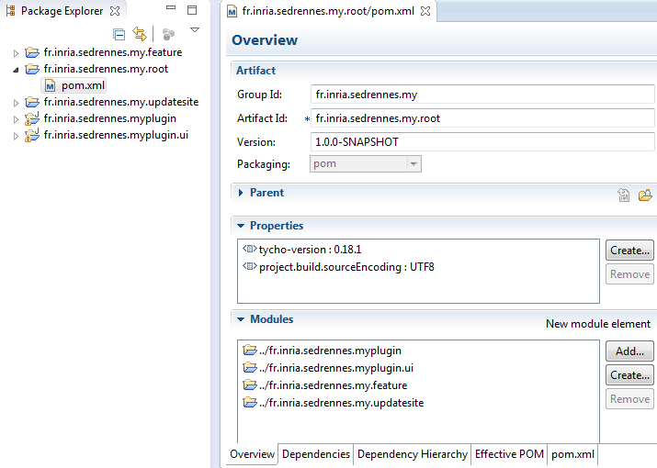
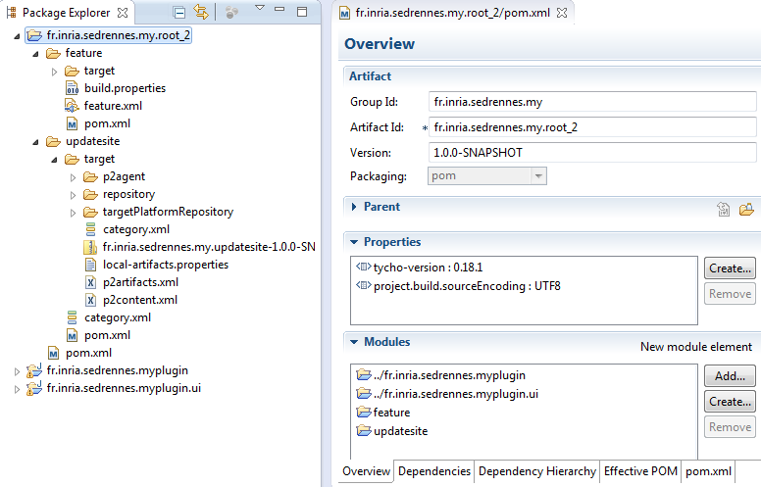
Possible folder organisation
Flat folder organisation
Folders partially nested
Recommanded for simple project but
Be careful about the pathes…

Slide 87
Tip
Manifest version(or feature) and maven artifact version must be compatible
Ex: 1.0.1 ~ 1.0.1
Ex: 1.0.0-qualifier ~ 1.0.0-SNAPSHOT
(automatically add the build time to the version)

Slide 88
Building product
Create a plugin implementing org.eclipse.core.runtime.products extension
Typically a dedicated "branding" plugin but can be put in any plugin
Customize about box, splash screen, welcome screen, icons, …
Add it to the modules known but root
Create a separate project that will build the product for the various OS
Add a dependency to the main feature
Some default launch parameters
Some info are duplicated between branding plugin and product file
Probably due to the build process and evolution of eclipse tooling

Slide 89
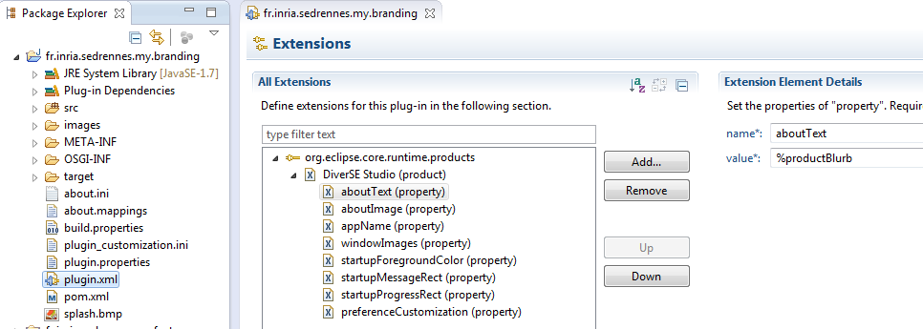
Branding plugin

Slide 90
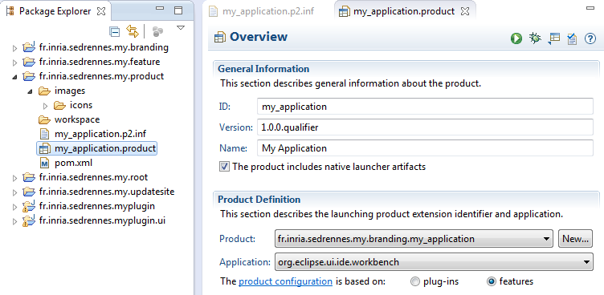
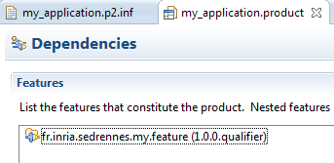
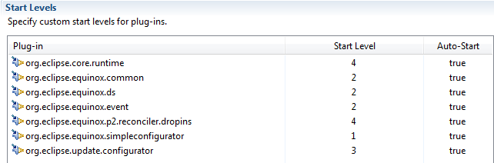
Product project (i)

Slide 91
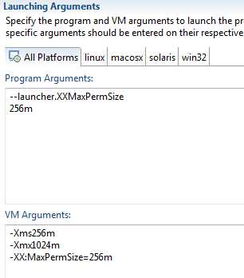
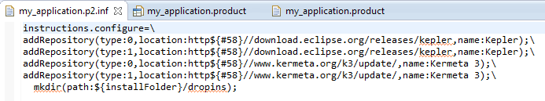
Product project (ii)
Some other configurations
Optionnaly the p2.inf file can contain preconfiguration value to be added in the
Ex: default update site added in the product

Slide 92
Best practices
Use the same name for
Project name
Folder name
Plugin name (Bundle symbolic name)
ArtifactId
Package name
-> use java naming convention (start with organisation / web)
TODO Add picture

Slide 93
Tip: enable ‘’ Import as > Project from a Repository ’’
Generate an Eclipse-SourceReferences entry in the manifest of all plugins
Simply add this to your root pom.xml
<properties>
<!-- url to your git repository used in Eclipse-SourceReferences MANIFEST header -->
<tycho.scmUrl>scm:git:https://github.com/dvojtise/eclipse-plugin-training.git</tycho.scmUrl>
</properties>
…
<plugin> <!-- enable generation of Eclipse-SourceReferences MANIFEST header -->
<groupId>org.eclipse.tycho</groupId>
<artifactId>tycho-packaging-plugin</artifactId>
<version>${tycho-version}</version>
<dependencies><dependency>
<groupId>org.eclipse.tycho.extras</groupId>
<artifactId>tycho-sourceref-jgit</artifactId>
<version>${tycho-version}</version>
</dependency></dependencies>
<configuration>
<sourceReferences><generate>true</generate></sourceReferences>
</configuration>
</plugin>

Slide 94
Tip: Enable source generation
Useful for SDK (simplify the debug)
<!-- enable source bundle generation -->
<plugin>
<groupId>org.eclipse.tycho</groupId>
<artifactId>tycho-source-plugin</artifactId>
<version>${tycho-version}</version>
<executions><execution>
<id>plugin-source</id>
<goals><goal>plugin-source</goal></goals>
</execution></executions>
</plugin>
<!-- enable source feature generation -->
<plugin>
<groupId>org.eclipse.tycho.extras</groupId>
<artifactId>tycho-source-feature-plugin</artifactId>
<version>${tycho-version}</version>
<executions><execution>
<id>source-feature</id>
<phase>package</phase>
<goals><goal>source-feature</goal></goals>
</execution></executions>
</plugin>
<plugin>
<groupId>org.eclipse.tycho</groupId>
<artifactId>tycho-p2-plugin</artifactId>
<version>${tycho-version}</version>
<executions><execution>
<id>attach-p2-metadata</id>
<phase>package</phase>
<goals><goal>p2-metadata</goal></goals>
</execution></executions>
</plugin>

Slide 95
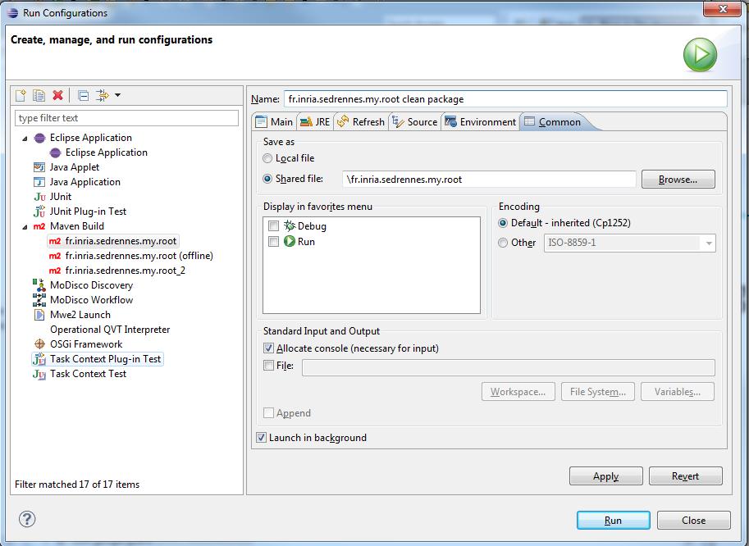
Tip
Save and share usual launch configurations

Slide 96


More complex project
Split in several groups
Each with its update site
Archive folder containing the resulting update site so it becomes a valid P2 repository URL
Ex: https://ci.inria.fr/k3al/job/k3-sle.eclipse/lastSuccessfulBuild/artifact/k3-sle.eclipse/fr.inria.diverse.k3.sle.p2updatesite/target/site/
Dependent components can refer to these repositories
Use promotion script to automate distribution to the official web server

Slide 97


Jenkins - promotion
Location of the build
Destination on the server
Do a time stamped copy for archive

Slide 98
Advanced Update sites
Composite update site
One adress that points to other update sites

Slide 99
Déploiement sous d'autres formes
Appel en ligne de commande
Application eclipse
Ou version standalone
Version Standalone (ie. Sans la pile OSGI)
Implique d'avoir plusieurs "packaging" en fonction des classes exposée et du manifest donc plusieurs pom.xml,
Ne pas espérer réutiliser le même jar pour tous les usages !

Slide 100
"Pluginiser" un jar issu de maven (i)
Objectif: redéployer un jar construits pour d'autres usages pour être utilisé dans eclipse
Ajout principalement d'un manisfest
Principe garder le jar original en tant que jar embarqué dans le plugin (si possible en automatisant la copie du jar)
Utiliser copy de maven-dependency-plugin
Faire référence au jar "interne" depuis le manifest

Slide 101


"Pluginiser" un jar issu de maven (ii)
Utiliser copy de maven-dependency-plugin
Faire référence au jar "interne" depuis le manifest
Exporter à la fois les classes du jar importé et du plugin lui même

Slide 102
Maveniser un jar issu de tycho
Objectif reconstruire manuellement les dependances pour les rendre disponibles depuis maven
Maven-Assembly plugin ou maven-shade

Slide 103
Enhancing your plugins
Eclipse Modeling Project
http://eclipse.org/modeling/
provides a large set of tools for model driven development. generate Java code to represent, serialize and de-serialize the model. Easily developp editors (graphical or textual)
Eclipse Communication Framework
http://eclipse.org/ecf
If your plugin requires any communication functionality, the ECF project is the first place to look
Business Intelligence and Reporting Tools
http://eclipse.org/birt
open source reporting system
…

Slide 104
References
http://www.vogella.com/tutorials/eclipse.html
http://refcardz.dzone.com/refcardz/eclipse-plug-development
http://refcardz.dzone.com/refcardz/getting-started-eclipse-rcp

Slide 105



Questions
?

Slide 106
Exercices
Plugin development
Create a simple builder plugin with dedicated project nature
Add an overlay image for the project nature
Deployment, build autiomation
Get the sample architecture
Build it
Make it minimalist (ie. Remove Eclipse SDK from the feature + startup services)
Automate creation of the update site deploying your plugin
Create a studio/product deploying an eclipse with your plugin

